Slide 1


Advanced Bash Scripting - 2
| DevOps and Cloud Computing

Slide 2

Objective
Utilize regular expressions for advanced pattern matching in Bash scripts.
Understand and use arrays and associative arrays in Bash.
Implement control structures such as if-else and loops for decision-making and iteration.
Work with Bash variables and parameters effectively.
Apply best practices for writing clean, efficient, and maintainable Bash scripts.

Slide 3
Regular expressions and their importance in pattern matching
| DevOps and Cloud Computing

Slide 4
Introducing Regular expressions
Regular expressions, often shortened to "regex," are sequences of characters that define a search pattern in text. They are a powerful tool used by programmers to locate, validate, or manipulate specific strings or patterns within text.
Regular expressions are essential for text processing, input validation, and searching algorithms.
Importance:
Pattern matching
Special characters
Flexibility
Use cases
Equivalents

Slide 5
Demonstrating using grep, sed, and awk with regular expressions for text processing
| DevOps and Cloud Computing

Slide 6
Let’s do it
Here are examples of how to use grep, sed, and awk with regular expressions for text processing:
Grep: This command searches for patterns in a file and prints the lines that match.
For example, grep "pattern" file.txt searches file.txt for lines containing "pattern“
Sed: This command replaces text using regular expressions.
For example, sed 's/oldstring/newstring/g' log.txt replaces all occurrences of "oldstring" with "newstring" in log.txt.
Awk: This command processes and manipulates text based on patterns.
For example, awk '{print $1, $3}' log.txt prints the first and third fields of each line in log.txt.

Slide 7
Pop Quiz
Q. For pattern-matching, awk uses regular expressions in which style?
A
sed
B
grep

Slide 8
Pop Quiz
Q. For pattern-matching, awk uses regular expressions in which style?
A
sed
B
grep

Slide 9
Pop Quiz
Q. Which command is used to search for a pattern in a file and print the lines that match the pattern?
A
grep
B
sed

Slide 10
Pop Quiz
Q. Which command is used to search for a pattern in a file and print the lines that match the pattern?
A
grep
B
sed

Slide 11
Providing examples of matching specific patterns
| DevOps and Cloud Computing

Slide 12
Examples
Here are examples of regular expressions that match specific patterns:
Matching an email address
Matching IP addresses
Matching 8 digits in a row
Matching positive integer literals
Matching full integer literals
Matching identifiers (or names)
Matching a single "a" followed by zero or more "b"s followed by "c"

Slide 13
Explain the difference between standard arrays and associative arrays.
| DevOps and Cloud Computing

Slide 14
Standard & Associated arrays
Standard arrays and associative arrays differ primarily in how elements are accessed:
Standard Arrays: Use sequential numeric indices to access elements. The index has to be an integer.
Associative Arrays: Use keys (any scalar value) to access elements. Keys are unique within the array. Associative arrays are also known as maps, dictionaries, or symbol tables.

Slide 15
Demonstrating creating, accessing, and manipulating arrays
| DevOps and Cloud Computing

Slide 16
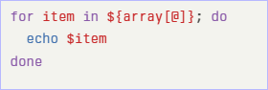
Let’s do it
Here's how to create, access, and manipulate arrays in Bash:
Standard Arrays (Indexed Arrays):
Creation: ‘array=(val1 val2 val3)’
Declaration (optional): ‘declare -a array name’
Accessing Elements: ‘${array[index num]}’
${array} will retrieve val1.
Looping through elements:

Slide 17
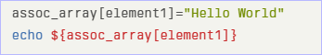
Let’s do it
Append elements: ‘array+=(new element)’
Insert elements: ‘array name[position]=element to be inserted’
Update elements: ‘example array[index]=updated element’
Associative Arrays:
Declaration: ‘declare -A assoc array’
Creation/Assignment: ‘assoc array[key]=value’
Accessing Elements: ‘${assoc array[key]}’
For example:

Slide 18


Take A 5-Minute Break!
Stretch and relax
Hydrate
Clear your mind
Be back in 5 minutes

Slide 19
Explaining if-else statements for conditional logic
| DevOps and Cloud Computing

Slide 20
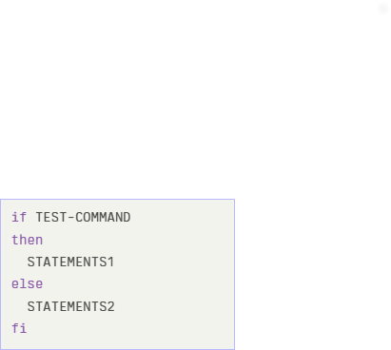
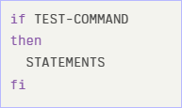
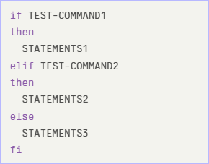
Let’s do it
‘if’, ‘if...else’, and ‘if...elif...else’ statements in Bash allow you to execute code based on conditions.
Basic syntax:

Slide 21
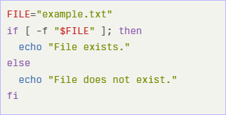
Let’s do it
Demonstrations:
Checking File Existence:

Slide 22
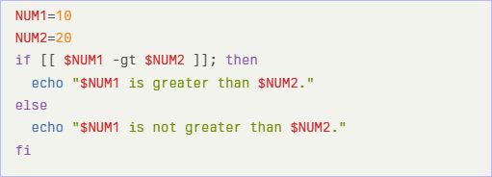
Let’s do it
Comparing Numbers:

Slide 23
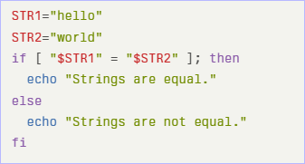
Let’s do it
Comparing Strings:

Slide 24
Pop Quiz
Q. Which keyword is used to check multiple conditions in an if statement?
A
elif
B
elseif

Slide 25
Pop Quiz
Q. Which keyword is used to check multiple conditions in an if statement?
A
elif
B
elseif

Slide 26
Introducing loops (for, while, until)
| DevOps and Cloud Computing

Slide 27
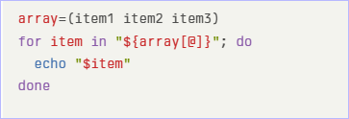
Let’s do it
Here's a short explanation of ‘for’, ‘while’, and ‘until’ loops in Bash, with examples of iteration:
1. ‘for’ Loop:
Used to iterate a known number of times, often through a list.
Iterating through an array:

Slide 28
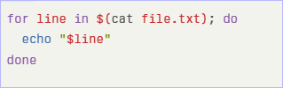
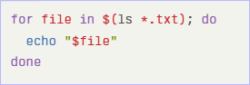
Let’s do it
Iterating through a file:
Iterating through command output:

Slide 29
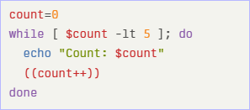
Let’s do it
2. while Loop:
Executes as long as a condition is true.

Slide 30
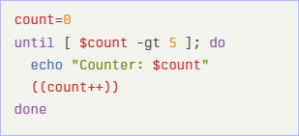
Let’s do it
3. ‘until’ Loop:
Executes as long as a condition is false.
It is the opposite of the ‘while’ loop

Slide 31
Pop Quiz
Q. What is NOT a keyword for looping in Bash?
A
until
B
each

Slide 32
Pop Quiz
Q. What is NOT a keyword for looping in Bash?
A
until
B
each

Slide 33
Explaining types of variables (local, global, special)
| DevOps and Cloud Computing

Slide 34
Types of variables
In Bash, variables can be categorized into three main types based on their scope and behavior:
Local Variables: These variables are accessible only within the function or code block where they are defined.
Global Variables: These variables are accessible throughout the script. Any variable defined outside a function is considered a global variable.
Special Variables (Environment Variables): These variables are set by the system and contain information about the environment, such as the user's home directory or the system path. To make a variable an environment variable, use the ‘export’ command. To list all environment variables, use the ‘env’ command.

Slide 35
Demonstrating parameter substitution
| DevOps and Cloud Computing

Slide 36
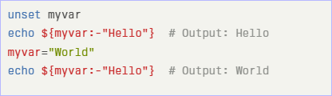
Let’s do it
Here's a demonstration of parameter substitution in Bash:
Default Values: ${var:-default}
If var is unset or null, the expansion results in default. Otherwise, the value of var is substituted

Slide 37
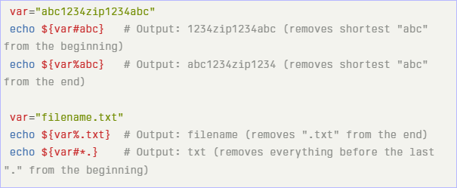
Let’s do it
2. String Manipulation:
${var%pattern}: Removes the shortest matching pattern from the suffix (end) of $var.
${var#pattern}: Removes the shortest matching pattern from the prefix (beginning) of $var.

Slide 38
Examples of passing arguments to scripts and accessing them
| DevOps and Cloud Computing

Slide 39
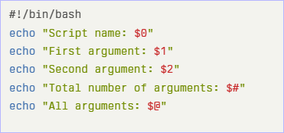
Examples
Passing Arguments: Arguments are passed to a Bash script by typing them on the command line after the script's name. For example: bash script.sh arg1 arg2.
Accessing Arguments: Inside the script, arguments are accessed using positional parameters:
Example:

Slide 40
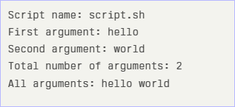
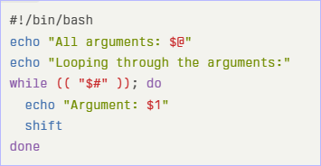
Examples
If you run above script with ‘bash script.sh hello world’, the output will be:
Handling Multiple Arguments:

Slide 41
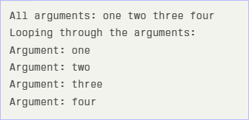
Examples
Running ‘bash script.sh one two three four’ will output:
Passing output of one script to another: You can also pass the output of one shell script as an argument to another shell script.

Slide 42
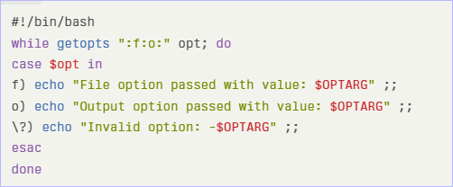
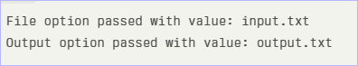
Examples
Running ‘bash script.sh -f input.txt -o output.txt’ will output:

Slide 43
Emphasizing writing readable and maintainable scripts
| DevOps and Cloud Computing

Slide 44
Let’s learn
To write readable and maintainable Bash scripts, emphasize the following:
Meaningful Variable Names
Comments
Input Validation
Error Handling
Consistency
Double Quote Variables
Use Local Variables
Use Descriptive Function Names
Use ‘[[‘ instead of ‘[‘ or test
Use ‘$( … )’ instead of backticks
Avoid Option Flags

Slide 45
Demonstrating the use of set -e, set -u, and set -o pipefail for robust scripts.
| DevOps and Cloud Computing

Slide 46
Let’s do it
To create robust Bash scripts, use the following ‘set’ commands:
‘set –e’ (or ‘set -o errexit’): This option causes the script to exit immediately if a command exits with a non-zero status.
‘set –u’ (or ‘set -o nounset’): This option treats unset variables as an error, causing the script to exit if an unset variable is used.
‘set -o pipefail’: This option causes a pipeline to return the exit status of the last command to exit with a non-zero status, even if other commands in the pipeline succeed.

Slide 47
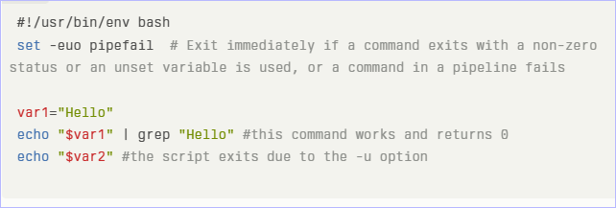
Let’s do it
Example: In this example, if ‘grep’ fails or ‘var2’ is unset, the script will exit.

Slide 48
Providing examples of modular scripting with functions
| DevOps and Cloud Computing

Slide 49
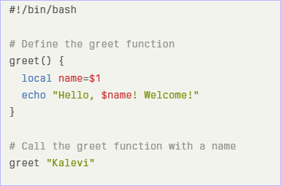
Examples
Here are examples of modular scripting with functions in Bash:
1. Greeting Function:

Slide 50
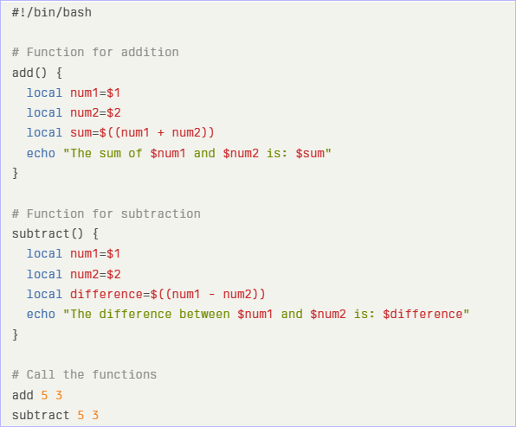
Examples
2. Arithmetic Functions:

Slide 51
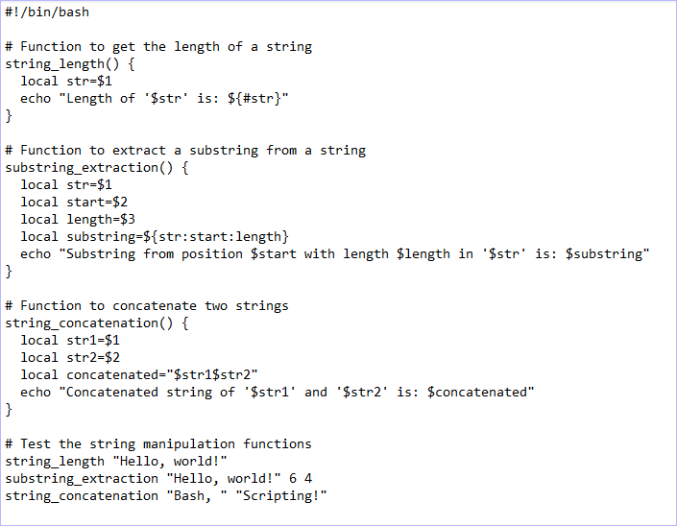
Examples
3. String Manipulation Functions:

Slide 52
Time for case study!

Slide 53
Important
Complete the post-class assessment
Complete assignments (if any)
Practice the concepts and techniques taught in this session
Review your lecture notes
Note down questions and queries regarding this session and consult the teaching assistants

Slide 54
Thanks!

